Slide 1
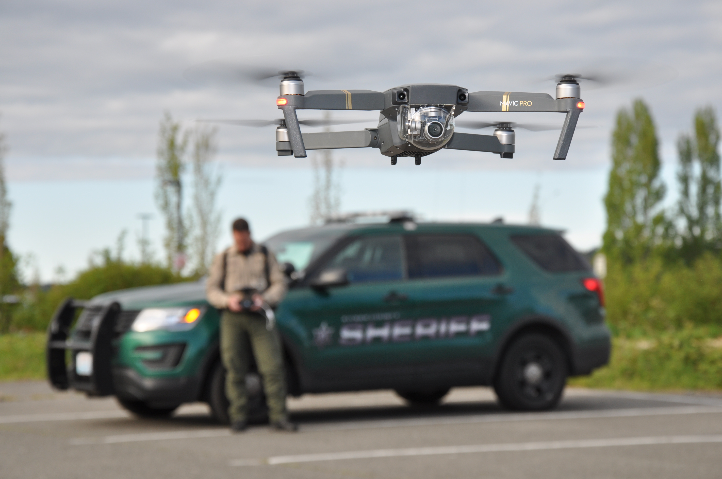
Kitsap county sheriff’s Office Unmanned Aerial System
Informational Presentation to Kitsap County Commissioners:
Charlotte Garrido, Ed Wolfe & Robert Gelder

Slide 2
What is a uas program?
Uas is an acronym for “unmanned aircraft system”
Also Known as: UAV (Unmanned aerial vehicle)
RC: Remote Control
sUAS: Small Unmanned Aerial System
Or
Commonly called - Drone

Slide 3
Becoming a standard tool
Numerous law enforcement, fire, search and rescue and emergency management agencies are using uas programs in washington state right now, and the number is growing every year
2015 – 6 Law enforcement agencies had uas programs (source-Policeone.com)
2017 – over 350 law enforcement agencies have uas programs (source-policeone.com)
The everyday presence of unmanned aircraft has become a part of our world
Cost is going down, technology is on the rise and programs are easily affordable
Uas programs are being used by numerous industries across the nation

Slide 4
What can a uas program offer kitsap county?
Higher quality crash and crime scene reconstruction
Search and rescue
Over watch for active scenes (k-9/swat)
Reconnaissance for active and barricaded scenes
Multimedia enhancement
Benefits of manned aircraft at a fraction of the cost with low risk

Slide 5
A program that is proving to pay for itself
50% reduction in on-scene processing time
Less staff hours to produce – Some scenes processed in minutes - VS - Hours
Increased officer safety when used as over watch or flying indoors to clear rooms

Slide 6
Crash and crime scene reconstruction
Less time on scene
Higher quality reconstructions
Less staff hours to produce
ACCURACY DOWN TO MILLIMETERS
ABILITY TO MEASURE AND VIEW FROM ANY POINT
MILLIONS OF REFERENCE POINTS
ANIMATION for Court presentations

Slide 7
Search & Rescue
Cover large areas quickly
Use of thermal cameras to locate persons in distress
Overhead view to manage, coordinate assets
Live downlink for real time view from multiple viewing locations

Slide 8
Swat applications
Reaching areas out of reach
overwatch
Clearing rooftops
Aerial photos of scenes
Live downlink to team members and command post.
Can be viewed off-site from secure internet broadcast

Slide 9
SWAT APPLICATIONS
SYSTEMS ARE CAPABLE OF CONTACTING WALLS OR “RESTING” AGAINST WINDOWS
LOOKING INTO WINDOWS FROM THE OUTSIDE PROVIDES INTEL AND CREATES BETTER PLANNING
Provides command post options that increases safety
Reduce liability = Reduced Costs

Slide 10
Major incident response
Survey areas cutoff by natural events/disasters
Inspect / photograph bridges
Inspect / photograph slide areas
Inspect / photograph flooded areas

Slide 11
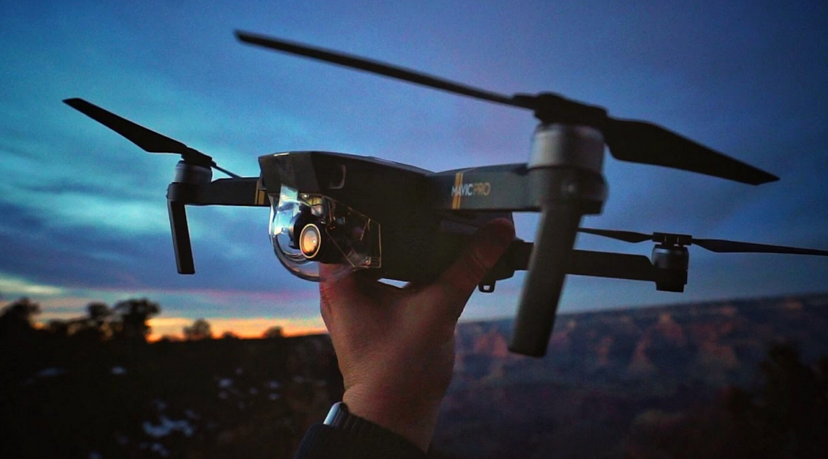
Where is kcso at in getting the program “Launched”
7 Deputies professionally trained in FAA regulations on ground & air space
Certificate of authorization (COA) from FAA (Pending any day)
kcso has a current uas policy
3 uas’s/equipment have been acquired
All operators certified with FAA Part 107 Remote pilot license

Slide 12
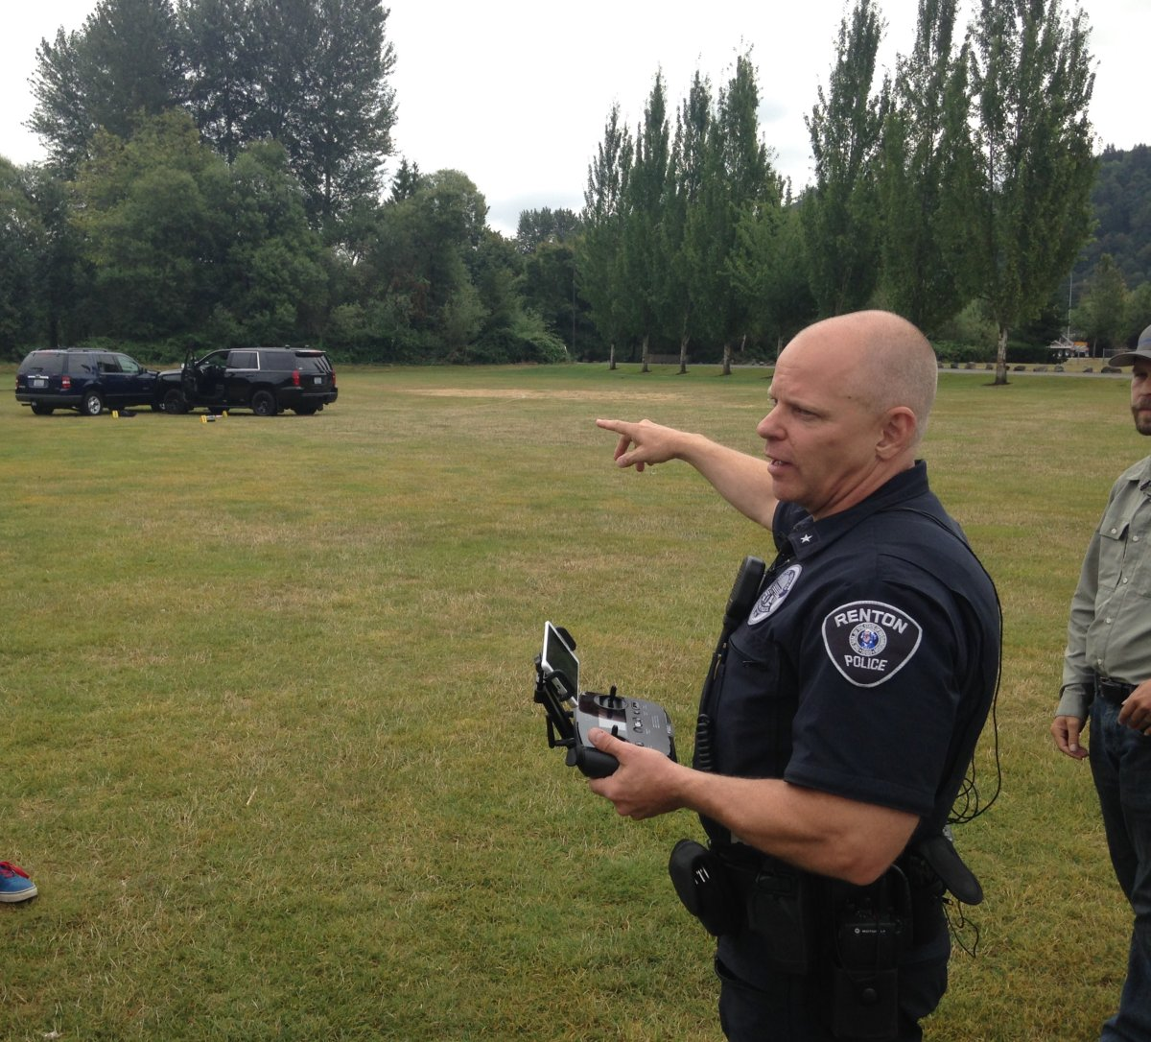
Other agencies with UAS Programs
Washington State Patrol
Renton Police Department
Tukwila Police Department
Kent Police Department
Auburn Police Department

Slide 13
The benefits of intergrating uas
Timely accident scene documentation and reconstruction
Enhanced Search & Rescue operations
Officer safety through better situational awareness
Rapid Crime scene documentation and reconstruction
Damage assessment during disaster response
More efficient with limited resources

Slide 14
Frequently asked questions???
Is there a Kitsap county ordinance that regulates UAS – Currently being developed
Are the UAS’s armed with weapons – No. Our policy prohibits this
Is a search warrant needed – The same requirements as with any other investigation
Primary use of a uas – accident/crime scene documentation
Other Questions?

